Slide 1
DIYALA UNIVERSITY
COLLEGE OF ENGINEERING
DEPARTMENT OF COMMUNICATION ENGINEERING
Electronic I
By
Asst. lecturer
WISAM HAYDER MAHDI
Lecture 2
Notes:
aaa

Slide 2
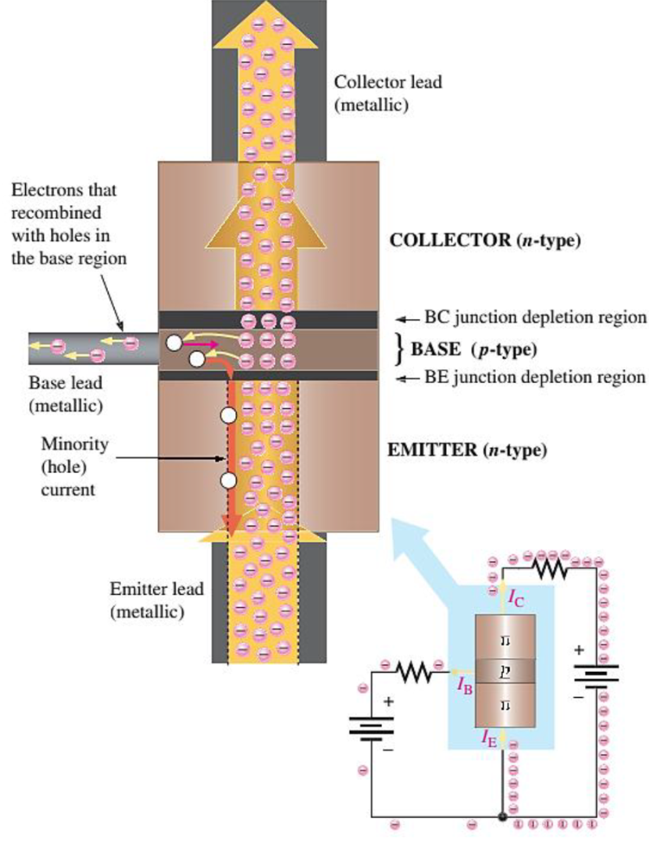
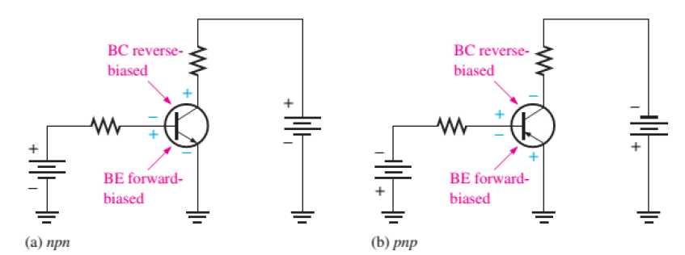
Transistor operation

Slide 3
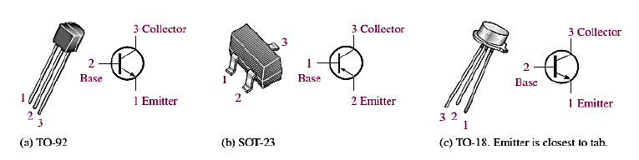
Transistor Categories
Manufacturers generally classify bipolar junction transistors into three broad categories:
1- General-Purpose/Small-Signal Transistors:- General purpose/ small-signal transistors are generally used for low- or medium-power amplifiers or switching circuits. Figure (1) show small signal transistors.
Figure (1) Small Signal Transistors

Slide 4
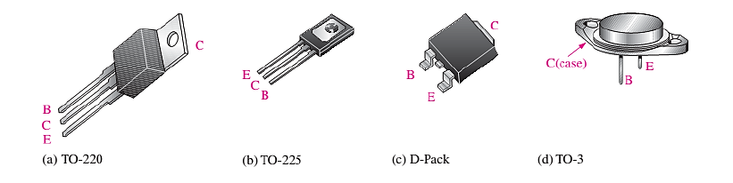
Transistor Categories
2- Power Transistors: - Power transistors are used to handle large currents (typically more than 1 A) and/or large voltages.
Figure (2) Examples of Power Transistors.

Slide 5
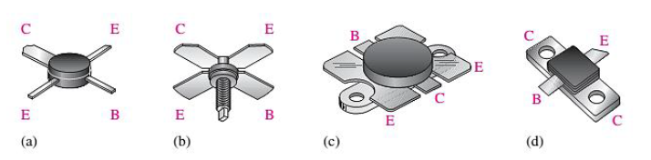
Transistor Categories
3- RF Transistors: - RF transistors are designed to operate at extremely high frequencies and are commonly used for various purposes in communications systems and other high frequency applications. Figure (3) show examples of RF transistors.
Figure (3) show examples of RF transistors

Slide 6
Transistor configurations
Objective: Shows the transistor connection configurations and the difference between them.
As we have seen, the bipolar transistor is a three- terminal device.
Three basic single transistor amplifier configurations can be formed; depending on which of the three transistor terminals is used as signal ground (i.e. which terminal is common to both the input and the output side of the configuration).

Slide 7
Transistor configurations
These three basic configurations are appropriately called common emitter, common collector and common base.
Figure (4) shows the three basic configurations for npn transistor.

Slide 8
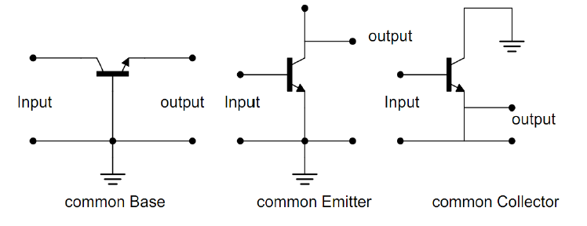
Transistor configurations
Figure (4) transistor configuration

Slide 9
Common Base Configuration
In figure (5) the npn and pnp transistor is shown in common base (CB) configuration.
The common base terminology derived from the fact that the base is common to both the input and output sides of the configuration.
In addition, the base is usually the terminal closest to, or at, ground potential.

Slide 10
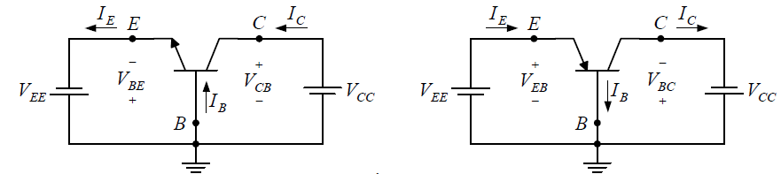
Common Base Configuration
Figure (5) common base configuration for npn and pnp transistor.

Slide 11
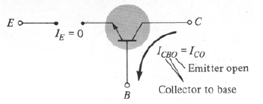
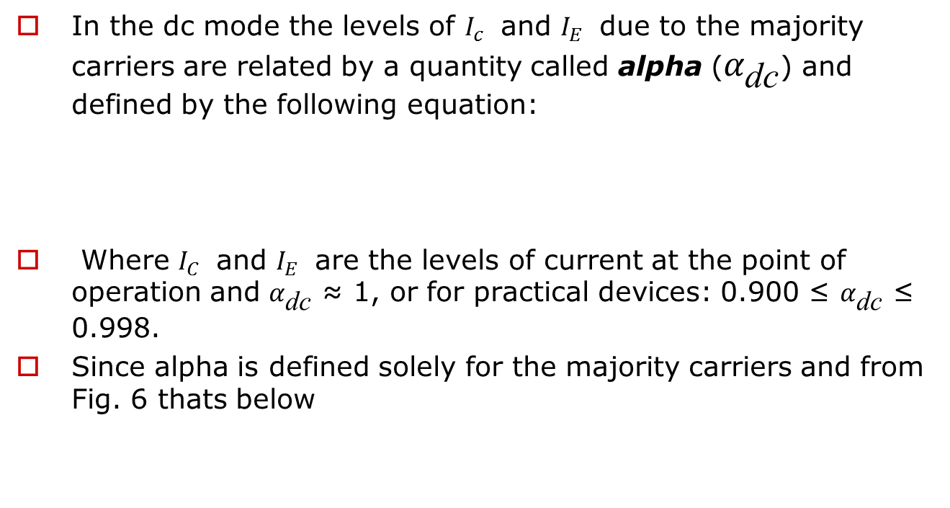
Common Base Configuration
In the dc mode the levels of $I_{c}$ and $I_{E}$ due to the majority carriers are related by a quantity called alpha ($α_{\text{dc}}$) and defined by the following equation:
Where $I_{C}$ and $I_{E}$ are the levels of current at the point of operation and $α_{\text{dc}}$ ≈ 1, or for practical devices: 0.900 ≤ $α_{\text{dc}}$ ≤ 0.998.
Since alpha is defined solely for the majority carriers and from Fig. 6 thats below

Slide 12
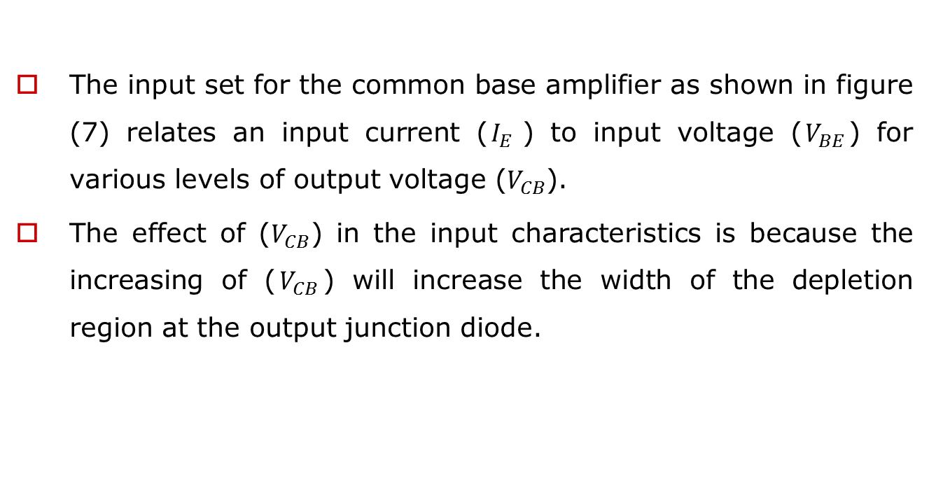
Common Base Configuration
The input set for the common base amplifier as shown in figure (7) relates an input current ($I_{E}$) to input voltage ($V_{BE}$) for various levels of output voltage ($V_{CB}$).
The effect of ($V_{CB}$) in the input characteristics is because the increasing of ($V_{CB}$) will increase the width of the depletion region at the output junction diode.

Slide 13
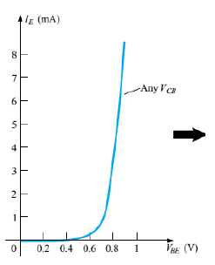
Common Base Configuration
Figure (7) input characteristics for npn transistor
The curves of figure (8) are known as the output or collector characteristics. There are three basic regions as indicated in the figure. These regions are :

Slide 14
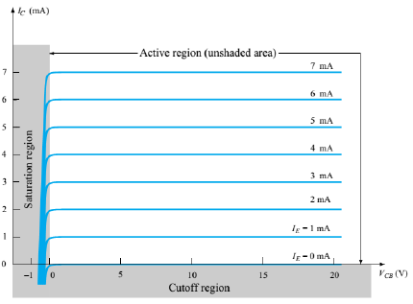
Common Base Configuration
The Active region: the collector-base junction is reverse-biased, while the base-emitter junction is forward-biased.
The Saturation region: the collector-base and base-emitter junctions are forward-biased.
The cutoff region: the collector-base and base emitter junctions of a transistor are both reverse biased
Figure (8) collector characteristics for npn transistor

Slide 15
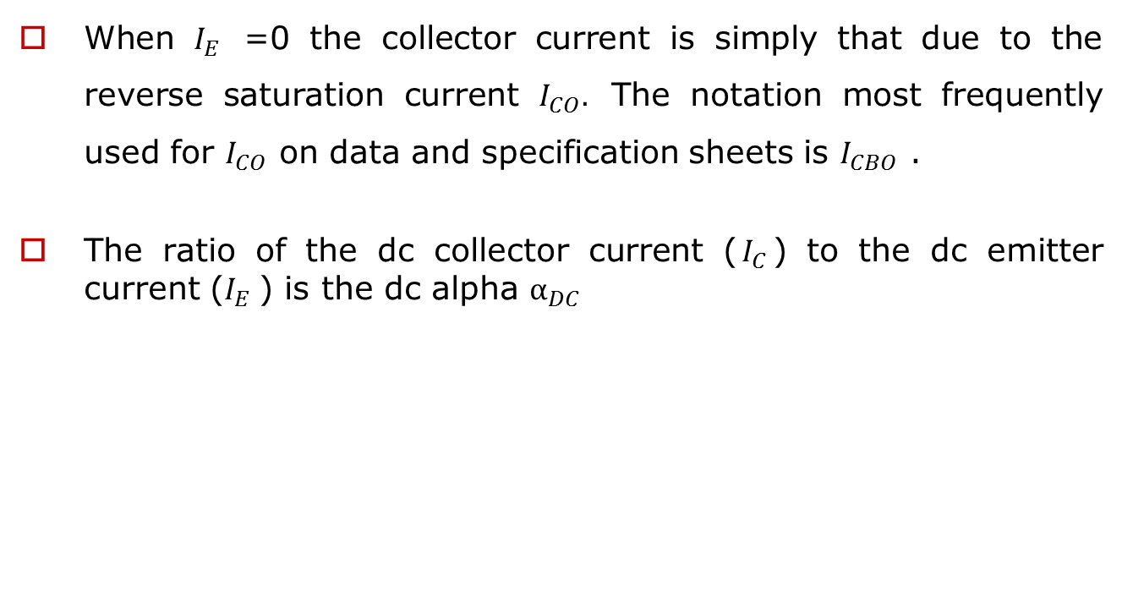
Common Base Configuration
When $I_{E}$ =0 the collector current is simply that due to the reverse saturation current $I_{CO}.$ The notation most frequently used for $I_{CO}$ on data and specification sheets is $I_{CBO}$ .
The ratio of the dc collector current ($I_{C}$) to the dc emitter current ($I_{E}$) is the dc alpha $α_{DC}$

Slide 16
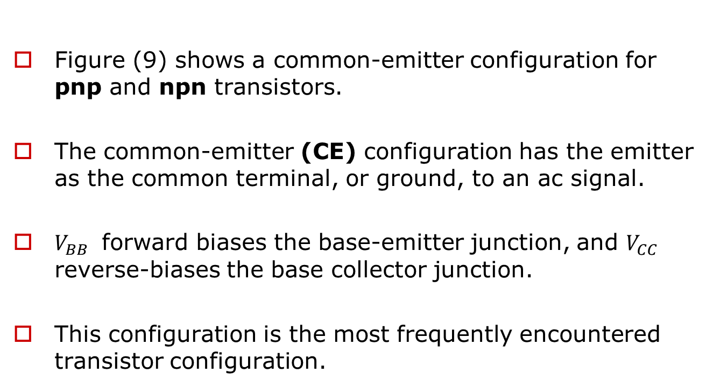
Common Emitter Configuration
Figure (9) shows a common-emitter configuration for pnp and npn transistors.
The common-emitter (CE) configuration has the emitter as the common terminal, or ground, to an ac signal.
$V_{BB}$ forward biases the base-emitter junction, and $V_{CC}$ reverse-biases the base collector junction.
This configuration is the most frequently encountered transistor configuration.

Slide 17
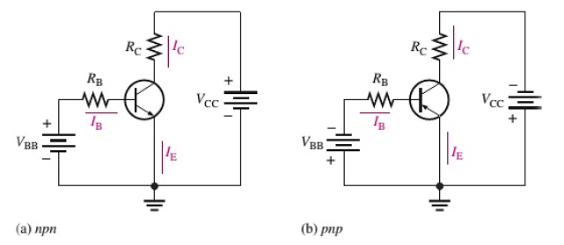
Common Emitter Configuration
Figure (9) Common Emitter Configuration.

Slide 18
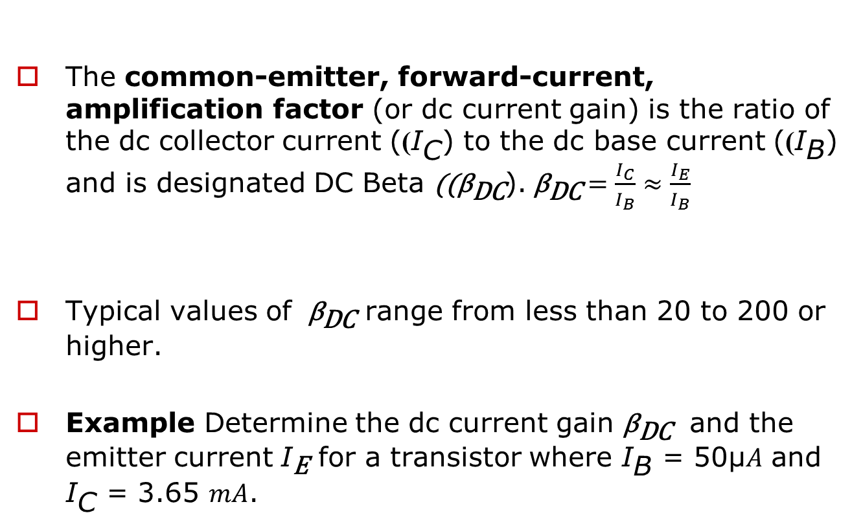

DC Beta (${\text{β}}_{\text{DC}}$)
The common-emitter, forward-current, amplification factor (or dc current gain) is the ratio of the dc collector current ((${\text{I}}_{\text{C}}$) to the dc base current ((${\text{I}}_{\text{B}}$) and is designated DC Beta ((${\text{β}}_{\text{DC}}$).${ \text{β}}_{\text{DC}} =\frac{I_{C}}{I_{B}}≈\frac{I_{E}}{I_{B}}$
Typical values of ${ \text{β}}_{\text{DC}}$ range from less than 20 to 200 or higher.
Example Determine the dc current gain ${\text{β}}_{\text{DC}}$ and the emitter current ${\text{I}}_{\text{E}}$ for a transistor where ${\text{I}}_{\text{B}}$ = 50μ𝐴 and ${\text{I}}_{\text{C}}$ = 3.65 𝑚𝐴.

Slide 19
Two sets of characteristics are necessary to describe fully the behavior of the common-emitter configuration:
One for the output or collector-emitter circuit and the other for the input or base-emitter circuit. Both are shown in Fig. (10).

Slide 20
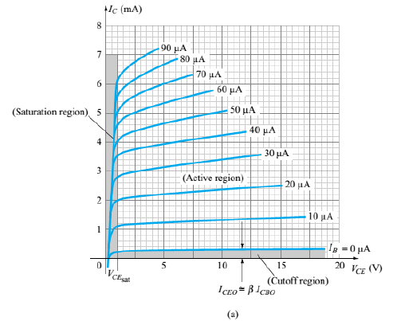
Figure (10) Characteristics of a silicon transistor in the common-emitter
configuration: (a) collector characteristics;

Slide 21
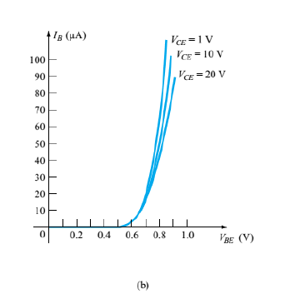
Figure (10) Characteristics of a silicon transistor in the common-emitter configuration: (b) base characteristics.

Slide 22
When the base-emitter junction is forward-biased, it is like a forward-biased diode and has a nominal forward voltage drop of transistor in the “on” or active region the base-to emitter voltage is 0.7 V
𝑉𝐵𝐸 = 0.7𝑉 𝑓𝑜𝑟 𝑠𝑖𝑙𝑖𝑐𝑜𝑛 and 0.3V for ge𝑟𝑚𝑎𝑛𝑖𝑢𝑚

Slide 23
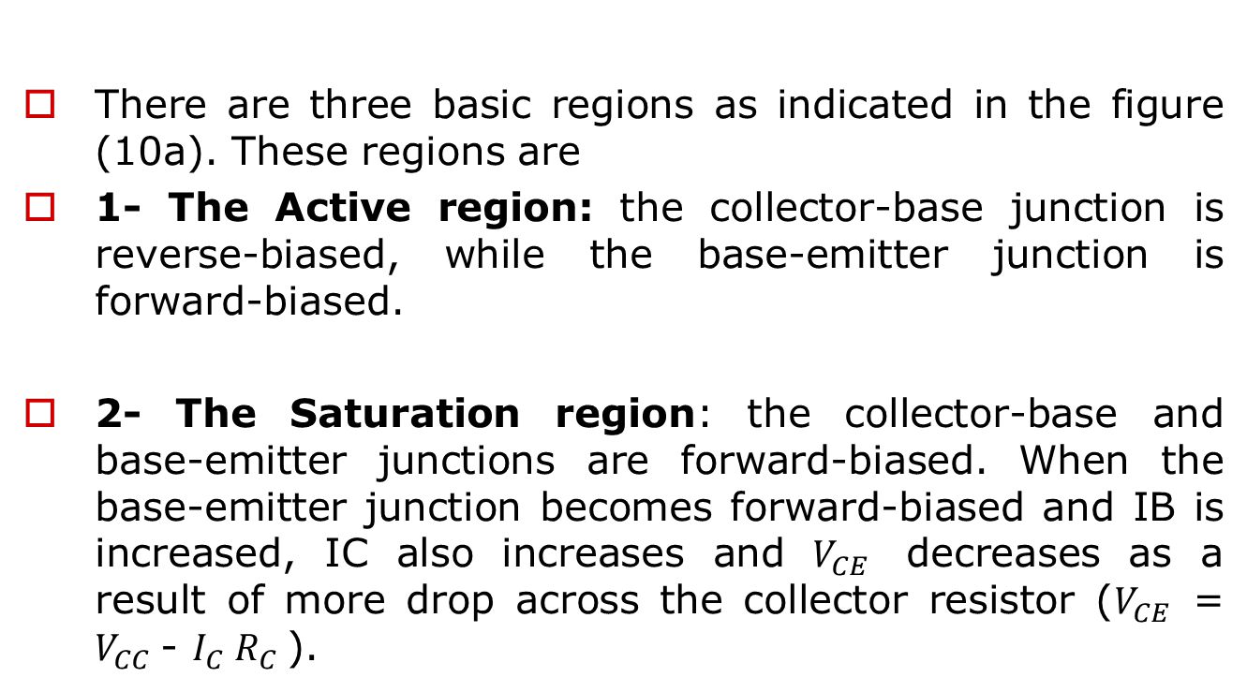
There are three basic regions as indicated in the figure (10a). These regions are
1- The Active region: the collector-base junction is reverse-biased, while the base-emitter junction is forward-biased.
2- The Saturation region: the collector-base and base-emitter junctions are forward-biased. When the base-emitter junction becomes forward-biased and IB is increased, IC also increases and $V_{CE}$ decreases as a result of more drop across the collector resistor ($V_{CE}$ = $V_{CC}$- $I_{C} R_{C}$).

Slide 24
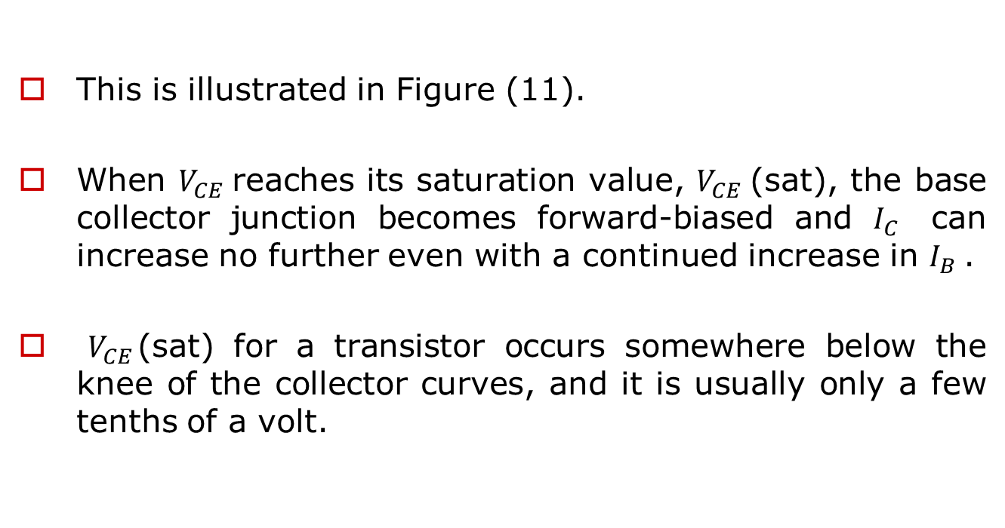
This is illustrated in Figure (11).
When $V_{CE}$reaches its saturation value, $V_{CE}$(sat), the base collector junction becomes forward-biased and $I_{C}$ can increase no further even with a continued increase in $I_{B}$.
$V_{CE}$(sat) for a transistor occurs somewhere below the knee of the collector curves, and it is usually only a few tenths of a volt.

Slide 25
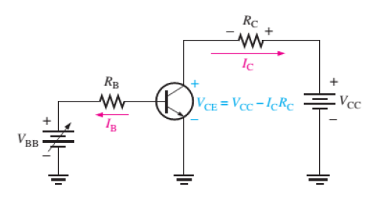

DC Beta (${\text{β}}_{\text{DC}}$)
Figure (11)

Slide 26
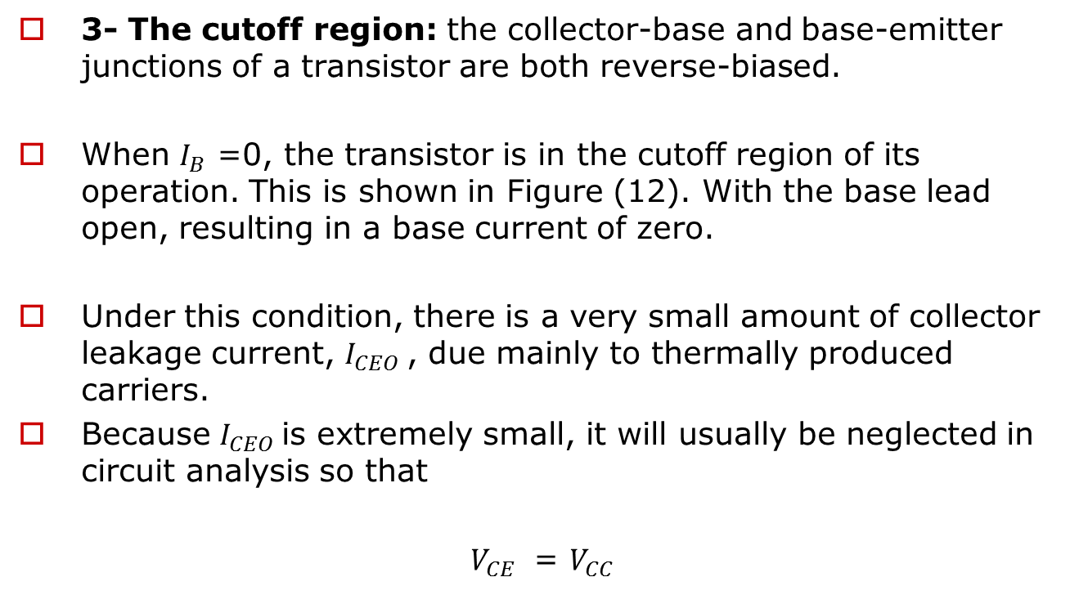
3- The cutoff region: the collector-base and base-emitter junctions of a transistor are both reverse-biased.
When $I_{B}$ =0, the transistor is in the cutoff region of its operation. This is shown in Figure (12). With the base lead open, resulting in a base current of zero.
Under this condition, there is a very small amount of collector leakage current, $I_{CEO}$, due mainly to thermally produced carriers.
Because $I_{CEO}$is extremely small, it will usually be neglected in circuit analysis so that
$V_{CE}$ = $V_{CC}$

Slide 27
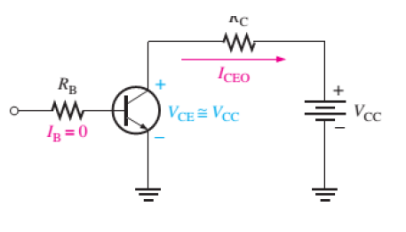
Figure (12)

